Slide 1


Gender Recognition By Voice

Slide 2

MEET THE TEAM
Guide
Amey Admane
Neha Pandey
A-15
A-52
Prof. Sweta Jain
Pratik Yawalkar
Vaidehi Choudhari
A-62
A-78

Slide 3
Content
Problem Definition
Project Scope
Technologies Used
Project Workflow
Model Implementation
Comparison/Results
Conclusion
Future Work
Future Challenges
References

Slide 4

Problem Definition
Identifying the gender using voice by training the Kaggle dataset using six machine learning models and comparing accuracy, precision, recall and F1 score of various models and suggesting the best model that can be used for gender recognition by voice.

Slide 5
Project Scope
Marketing
Public Service Based Sectors
Smart Assistance
Investigating Criminal Voice in crime scenarios

Slide 6





Jupyter Notebook
Kaggle Dataset
01
02
Data Science Libraries
HTML, CSS, JS, Django
03
04
Technologies Used
For implementing the project
Dataset consisting of recorded voice sample for testing
Numpy, Matplotlib, Pandas, Seaborn

Slide 7

Timeline 11 Jan - 20 April

Slide 8

Project WorkFlow
A brief summary of our project’s workflow . . . . .

Slide 9
Voice (.CSV)
Dataset
Preprocessing
Checking for
null values
Split Data
Train and test data
Scaling
Normalizing the values
Default Implementation
RF, GB, DT,KNN,SVM,
Logistic , Ensemble
Hyperparameter Tuning
Best parameters using GridSearchCV
Recursive Feature Elimination
Training the model using best features
Predict

Slide 10
Our Dataset
Dataset taken from Kaggle
https://www.kaggle.com/datasets/primaryobjects/voicegender?resource=download
3168 total records
It consists of 21 features meanfreq,sd,median,Q25,Q75,IQR,skew,kurt,sp.ent,sfm,mode,centroid, peakf, meanfun, minfun, maxfun, meandom,mindom,maxdom, dfrange,modindx,label
3168
1584
1584
Dataset (3168 x 21)

Slide 11

Model Implementation

Slide 12
For every model . . .
Hyperparameter Tuning using GridSearchCV
Recursive Feature Elimination
Default Model
Best Model

Slide 13
Comparison between Models

Slide 14
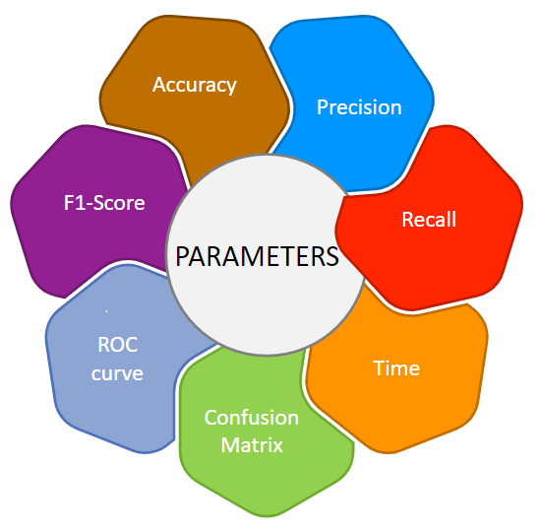
Parameters for Comparison

Slide 15
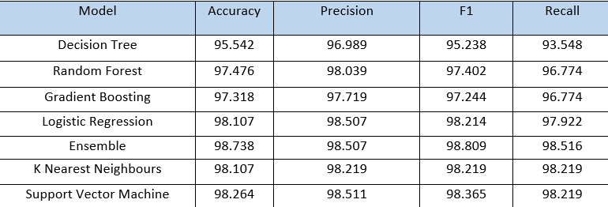
RESULTS
Model Results

Slide 16
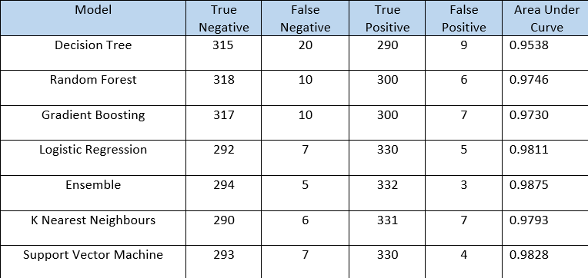
2. Results From Confusion Matrix and ROC Curve

Slide 17
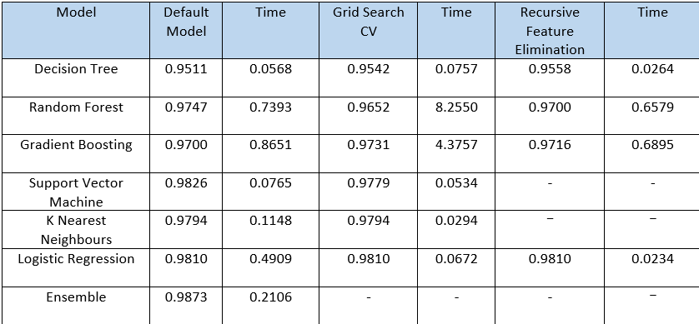
3. Accuracy & Time

Slide 18
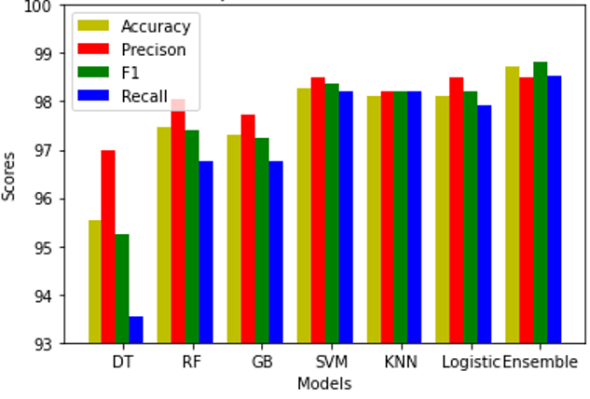
4. Graphical representation

Slide 19
Conclusion
We successfully trained the kaggle dataset using 7 machine learning models.
Out of all the 7 models implemented, Ensemble machine models performed better than other models.
Out of the 3 Ensemble models, Ensemble model build using SVM,Logistic regression and KNN performed the best.
Best case accuracy of Ensemble model is 98.738% followed by SVM.

Slide 20
Future Work
Audio files
R file to extract features
Converting data to .csv
Trained Model
Predict

Slide 21
Challenges
Low accuracy for real time data
Voice mimicry
Disturbances

Slide 22
References
https://www.kaggle.com/primaryobjects/voicegender
http://cs229.stanford.edu/proj2014/Kunyu%20Chen,%20Gender%20Identification%20by%20Voice.pdf
https://github.com/Kashika31/Gender-Recognition-by-Voice-Using-Machine-Learning/blob/master/Project%20Report.pdf
https://www.analyticsvidhya.com/blog/2020/04/confusion-matrix-machine-learning/
https://www.analyticsvidhya.com/blog/2021/08/decision-tree-algorithm/
https://www.analyticsvidhya.com/blog/2021/09/gradient-boosting-algorithm-a-complete-guide-for-beginners/
https://www.analyticsvidhya.com/blog/2021/06/understanding-random-forest/
https://www.analyticsvidhya.com/blog/2017/09/understaing-support-vector-machine-example-code/
https://www.analyticsvidhya.com/blog/2021/05/logistic-regression-supervised-learning-algorithm-for-classification/
https://www.javatpoint.com/k-nearest-neighbor-algorithm-for-machine-learning
http://www.repository.voxforge1.org/downloads/SpeechCorpus/Trunk/Audio/Main/16kHz_16bit/

